Slide 1
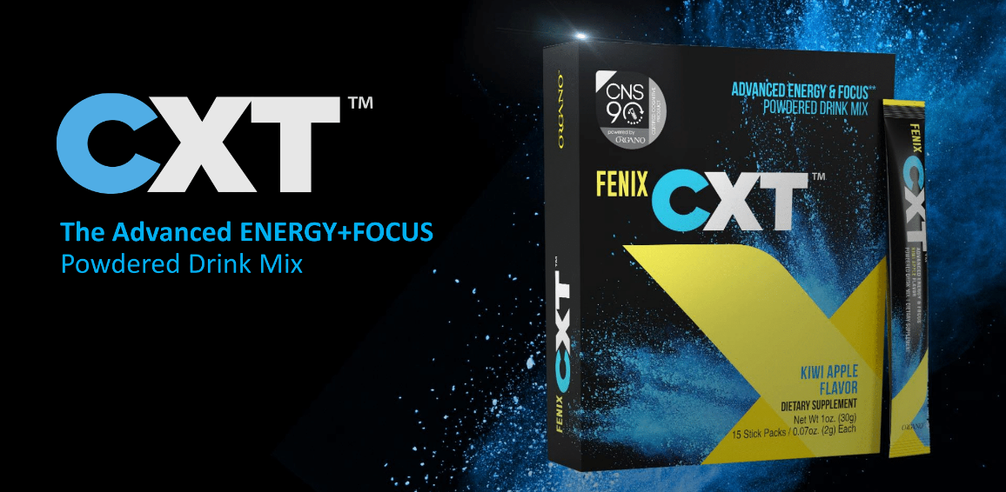
Fenix CXT™
Advanced Energy & Focus Powdered Drink Mix
Introduced at Unite 2021 Global Virtual Event

Slide 2
Fenix CXT™ – A New Addition to Organo Cognitive Nutrition System

Slide 4
What is it?
Organo Fenix CXT™ helps provide a unique way to support your body, and your brain with healthy energy.
More than a common energy drink, this unique blend is designed to support cognitive function and focus, along with the ‘gut brain’ axis so important to good health.
Energy to fuel thinking, mental clarity and focus, without the high caffeine or jittery feeling of other brands.

Slide 5
What is it?
Organo Fenix CXT™ is smooth, clean energy to fuel your day in a refreshing Kiwi & apple flavored powder mix.
There is a reason we have all heard “an apple a day” is good for us - and this apple & kiwi drink is like a powerhouse of good nutrition for your brain.
Combine that with ‘brain training’ and just like flexing your muscles, you will be flexing your brain to help keep it feeling strong, youthful, alert and awake with energy and focus!

Slide 8
Did You Know?
You have almost 10x more bacteria in the gut, than we do cells in our entire body.
This 3-5 pounds of bacteria is made up of good (probiotic) bacteria, and not so good bacteria.
Probiotics can help support good immune health – but also good brain health.
This is because 95% of our serotonin is in our gut, and this is what impacts our mood, our sleep, and our brain.
So, balance your gut, balance your brain, and you can do that with a healthy diet, fiber, and probiotics.

Slide 10
When Will Fenix CXT™ Be Available?
The samples of Fenix CXT™ were given to our top leaders to try out.
The top 3 winners for 48-hours promo of the Unite 2021 Event will get the samples before anyone else to enjoy the new product.
The tentative launch time for the US & Canada will be in March 2021.
The launch in other regions and countries will come after.
The pricing and the packaging are yet to be finalized as of Feb 2021.

